Slide 1
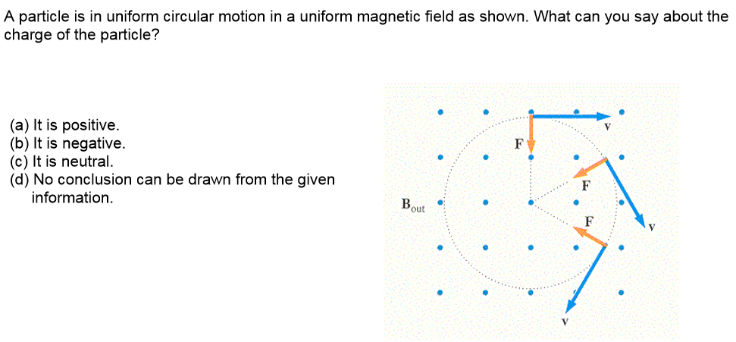
A

Slide 2
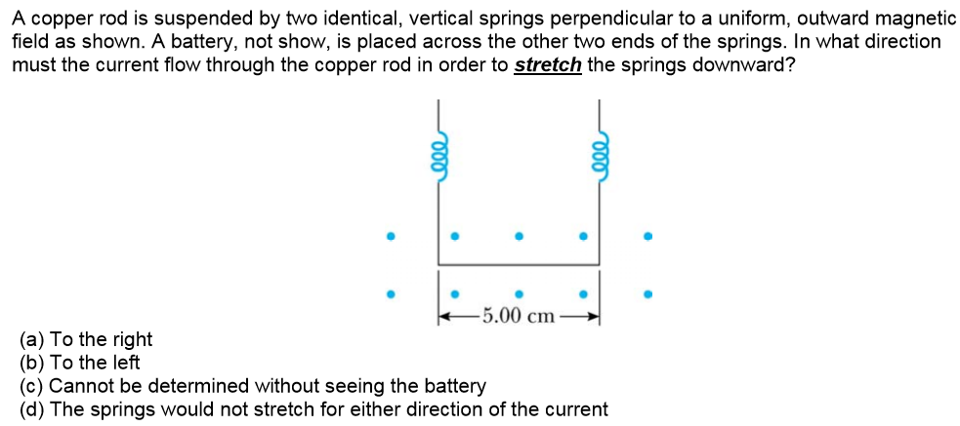
A

Slide 3
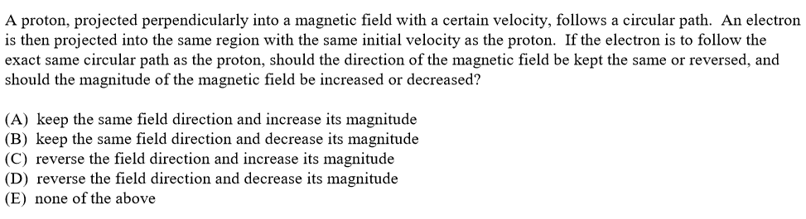
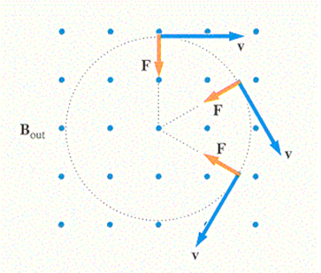
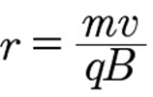
D
Proton: +e
Electron: -e
Same direction of F
Reverse the field
Electron has smaller mass
Decrease the field

Slide 4
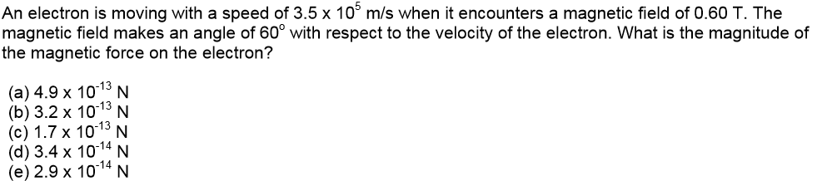


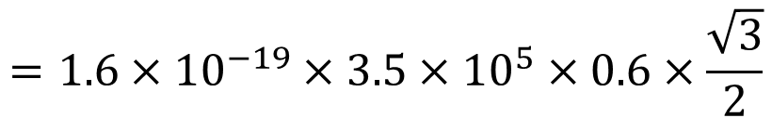
E
$$=1.6×{10}^{−19}×3.5×{10}^{5}×0.6×\frac{\sqrt{3}}{2}$$
$$=2.9×{10}^{−14}N$$

Slide 5
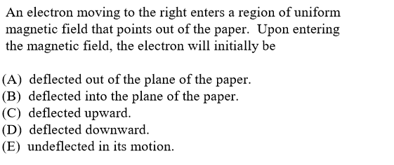
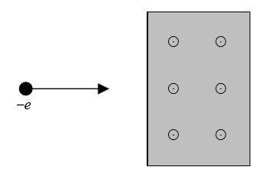
C

Slide 6
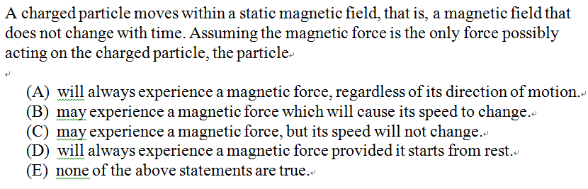
C
Velocity NOT parallel to magnetic field
magnetic force always perpendicular to the velocity
magnetic force changes the direction of the velocity, NOT the speed

Slide 7
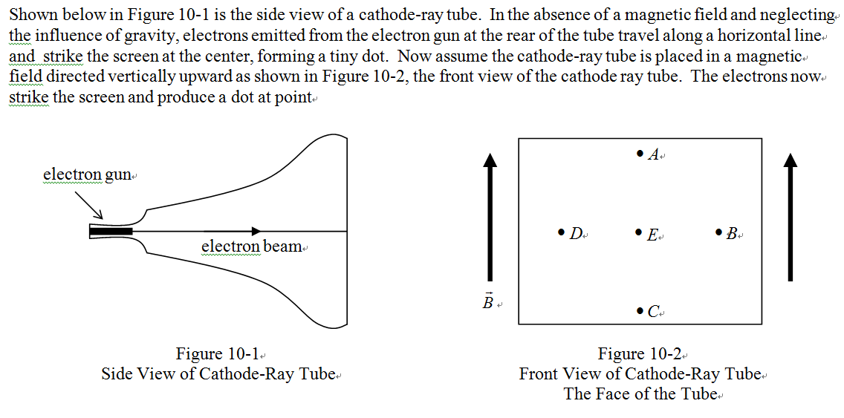
D
F

Slide 8
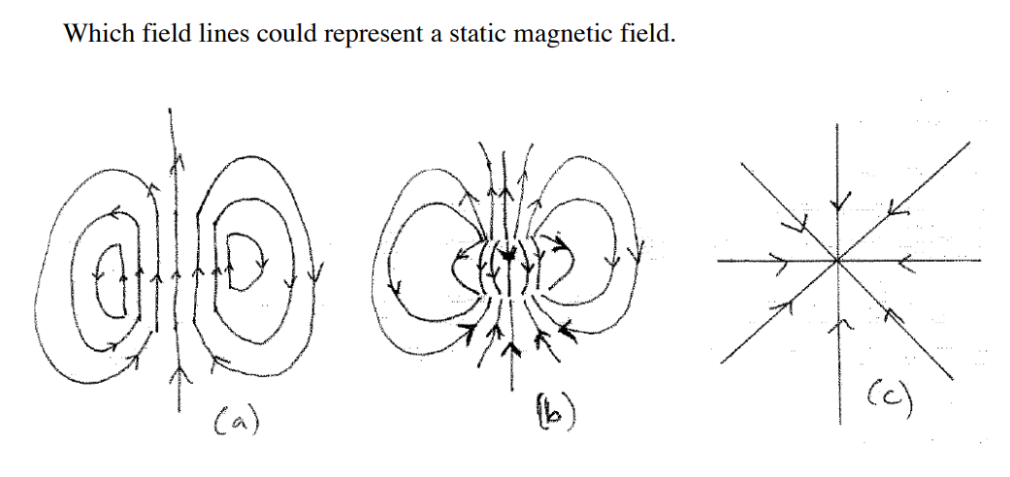
√
X
X

Slide 9
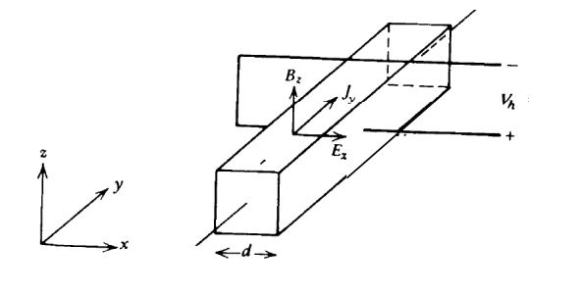
Hall effect: A uniform magnetic field B₀ in the z-direction is applied to a semiconducting material carrying current in the y-direction. In steady state, a voltage develops across d and the charge velocity v_{y} does not vary (electric and magnetic forces balance). What is the polarity of the charge carriers (n-type vs. p-type semiconductor)?
-
+
-
+
-
+
I
F_{B}⁺
Positive (p-type)

Slide 10
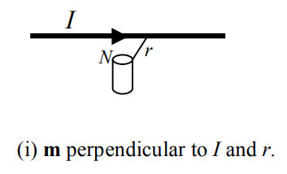
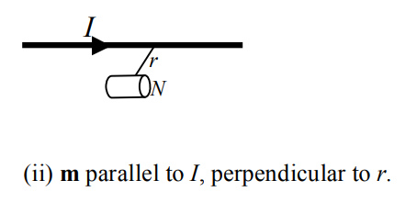
A bar magnetic with magnetic dipole m is place on a desk top, a distance r from an infinitely long wire carrying current I, which is also on the desk top. What are the directions of the forces on the wires for the two orientations shown?
B
m
m
E
A
B
C
D
E
F
.
X

